Slide 1
prop·a·gan·da
/ˌpräpəˈgandə/
Noun
Information, especially of a biased or misleading nature, used to promote or publicize a particular political cause or point of view.
Often uses exaggeration and/or lies.

Slide 2
If you see blue text, copy it down on your paper. Start with this information.
President Wilson set up the Committee on Public Information to build support for the war.
Wilson selected former muckraker George Creel to head the organization.
Creel persuaded advertisers and artists to create thousands of posters, cartoons, paintings, etc. to do this – he called them “four minute men”.

Slide 3
One of the goals: demonize the enemy so Americans wanted to fight them.
Who are the two figures in this poster?

Slide 4
This tactic was also used to inspire men to join the military.
Who do you think the “mad brute” is?
Where is he in this picture? Look under his feet!

Slide 5
To help pay for the war, the government sold liberty bonds to people, promising to pay them back after the war.
Notice how the artist draws the German soldier, and calls him a “Hun” – a reference to an older, barbaric group of people that terrorized Europe.

Slide 6
Here is another one.
Belgium was one of the first countries the Germans invaded early in the war.
How do you think German-Americans reacted to propaganda like this?

Slide 7
How do you think other Americans began to feel about German-Americans with propaganda posters like these?

Slide 8
Who or what is the “menace of the seas” shown here?
Notice the bloody knife coming up from under the water. What does the picture symbolize?

Slide 9
Propaganda was also used to make people feel more patriotic, or proud about their country.
The artists wanted to show that the democracy (rule by the people) of America and the Allied Powers was “civilized,” unlike the autocracy (rule by one person) of the Central Powers.

Slide 10
Artists also wanted to make Americans feel guilty for not supporting the war in the best way they could.
For men, this meant joining the military

Slide 11
This famous poster was created during WWI. Notice how the government is shown as a wise older man – “Uncle Sam.”

Slide 12
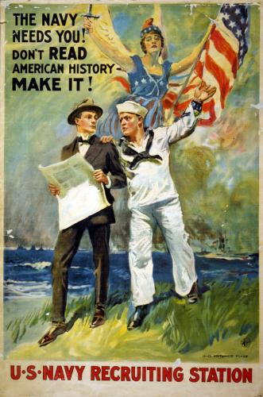

Slide 14
Turning boys into MEN!
Notice the figure under the word “Character.” What is he? Notice the armor, and especially the flag he is holding.

Slide 15
Even if you couldn’t fight, you were expected to help out like this man – using a riveter.
During the war, the government set up the War Industries Board to regulate industry, reduce waste, and speed up production. They told many businesses what to produce, and how much. They even set prices for some things.

Slide 16
To maintain high levels of efficiency, the government set up the National War Labor Board in 1918 to help settle disputes with labor unions. It improved factory conditions, promoted safety inspections
Why do you think it would have been a bad idea to ignore workers during the war?

Slide 17
Women were encouraged to become involved as well. Many became nurses during the war.

Slide 18
Others went to work in the factories and other industry, picking up jobs that men left behind to go off and fight.

Slide 19
Notice any African Americans in the propaganda? Even though you don’t, know that:
Many African Americans began to leave the south where they faced hatred and segregation and moved north – especially to cities – to work in factories and seek a better life. This was known as the Great Migration.

Slide 20
EVERYONE was encouraged to help support the war effort.

Slide 21
The government encouraged farmers to increase production, and families to grow and maintain a garden at home. Our troops and our allies needed FOOD!

Slide 22
The government also encouraged Americans to sacrifice for the war effort, sponsoring “Meatless Mondays” and “Wheatless Wednesdays” where they would not eat certain foods.

Slide 23
The Down Sides
With such an emphasis on patriotism and making the enemy look evil, Americans began to distrust immigrants even more. If it wasn’t “American,” it was suspicious.
German words were replaced with alternatives:
“Hamburger” (named after a German town) became “Salisbury steak” or the “Liberty Sandwich”
“Sourkraut” became “liberty cabbage”

Slide 24
The Down Sides
The government passed the Espionage and Sedition Acts, making it illegal to interfere with the war effort, or even say something disloyal against the government. Many believed these laws violated the 1st Amendment (freedom of speech).
Socialists and labor leaders were especially targeted. Eugene V. Debs was arrested and imprisoned for 10 years for criticizing the war and the draft. Emma Goldman was deported with many others, sent away on a ship to Russia.

Slide 25
Schenck v. United States (1919)
Charles Schenck – a Socialist leader. Distributed pamphlets criticizing the draft.
Schenck was arrested, but appealed his case to the Supreme Court, arguing that the Espionage and Sedition Acts were unconstitutional.
The Court ruled unanimously certain limits on the 1st Amendment were OK – you cannot, with your free speech, create a “clear and present danger” such as yelling “FIRE!” in a crowded movie theater.

Slide 26
Your Turn!
Create a propaganda poster of your own. Remember, the purpose of propaganda is to persuade people that something is either very good or very bad – even if that requires exaggeration or lies. Here are some ideas:
Convince people to buy war bonds.
Convince men to join the army, navy, etc.
Convince people that the enemy is evil and must be defeated.
Or, come up with your own idea.

