Slide 1
The Red Scare
Could it happen here!?

Slide 2
Economic Questions
What to produce? Who decides?
How to make the product? Means of Production
Who will get it? Distribution

Slide 3
Spectrums

Slide 4
Calculated Strategy
Lenin exiled previously, for stirring up dissent.
Germans let him back into Russia in 1918 on a sealed train. Why?

Slide 5
The Bolsheviks
Lenin’s Promise:
“Peace, Land, and Bread”
Appealed to industrial workers and peasants alike.
Marx: inevitable progression, through capitalism, to socialism. Lenin: we can bypass capitalism through armed revolution, go straight to socialism.

Slide 6
Anti-Bolshevik Propaganda – ca. 1918

Slide 7
The Comintern

Slide 8
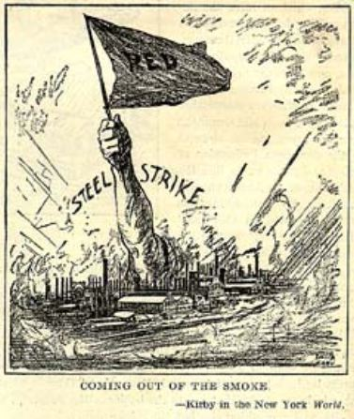
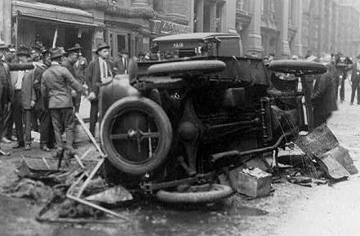
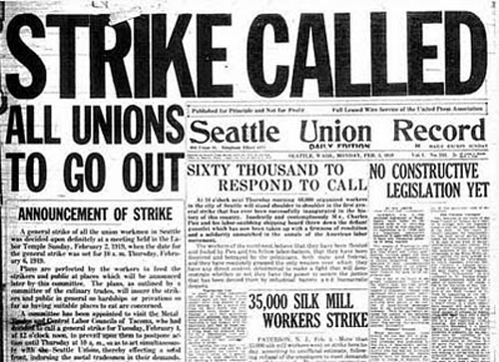
Meanwhile, Back at Home…

Slide 9
The Sedition Act
The Sedition Act – 1918 was an Act of the US Congress signed into law by President Wilson on May 16, 1918. It forbade the use of "disloyal, profane, scurrilous, or abusive language" about the United States government, its flag, or its armed forces or that caused others to view the American government or its institutions with contempt.
Made deportation process much easier.

Slide 10
Emma Goldman

Slide 11
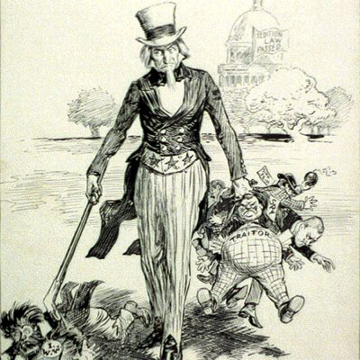

Slide 12
Atty. Gen. A. Mitchell Palmer

Slide 13
Palmer Raids

Slide 14
The “Soviet Ark” – USS Buford

Slide 15
Sacco & Vanzetti

Slide 16
Nativism
Nativism: a policy favoring the interests of established inhabitants over those of immigrants (the fear of foreigners).

Slide 17
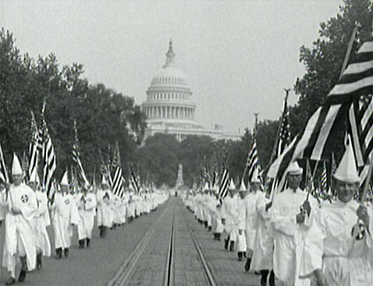
Nativism

Slide 18
Immigration Policy Changes
Immigration Acts
1921 – “Emergency Quota Act” (3% 1910 Census)
1924 – National Origins Act (2% 1890 Census)
Targeted Southern/Eastern European Immigrants
Prohibited Middle-Eastern, Asian Immigrants
1929 – Cap of 150,000 annually (instead of %)

