Slide 1
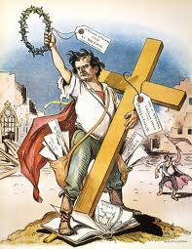
Clash of Cultures Cycle
Reservation Boundaries Set
Settlers/Gold Miners Violate Boundaries
Native Americans Respond with Attacks & Raids
U.S. Government Sends in the Cavalry
Growth of Populism
Greenback Parties
Populist Party
The Grange
Farmers’ Alliances

