Slide 1
Which type of government is being described?
A religious leader rules a nation according to the principles of a holy book.
A person backed by the army assassinates the ruler of a nation and declares that he is now the ruler.
A queen has total control of a nation. Her word is law.
A queen is the symbolic ruler of her nation. An elected legislature governs.
The legislators are elected by a vote of the people; they choose an executive from among themselves.
A legislative body and an executive are elected separately by voters.

Slide 2
Which type of government is being described?
A religious leader rules a nation according to the principles of a holy book. Theocracy
A person backed by the army assassinates the ruler of a nation and declares that he is now the ruler. Dictatorship
A queen has total control of a nation. Her word is law. Absolute monarchy
A queen is the symbolic ruler of her nation. An elected legislature governs. Constitutional monarchy
The legislators are elected by a vote of the people; they choose an executive from among themselves. Parliamentary democracy
A legislative body and an executive are elected separately by voters. Presidential democracy

Slide 3
O.G.T. Review
Types of Economies

Slide 4
What is Economics?
Economics is the science of decision making.
All of us have things that we want, as well as things that we need.
Why can’t we have everything that we want?
Resources are SCARCE! (they are limited)
This forces us to make choices.
How those choices are made depend on the economic system you live under.

Slide 6
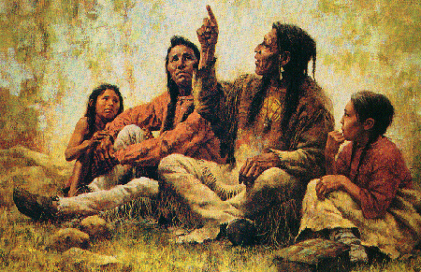
Traditional Economy
Economic decisions are based on custom, culture, and habit.

Slide 7
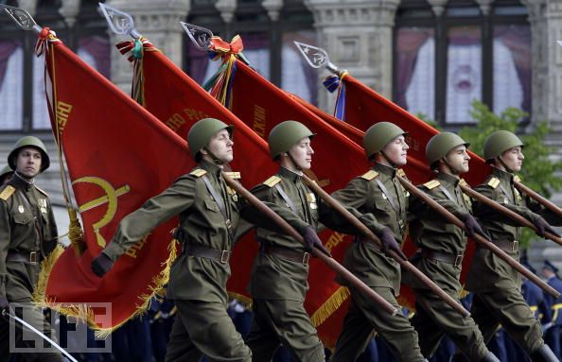
Command Economy
The government makes most of the economic decisions.

Slide 8
Market Economy
Ruled by supply and demand; people own property and make decisions that drive the economy

Slide 9
Mixed Economy
Contains elements of both market and command economies

Slide 10
Economic Systems | What to Produce? | How to Produce? | Who will consume them?
Market |  |  | Whoever can afford the goods and services
Mixed | Businesses determine based on consumer choice, with some government regulation
Command
Traditional

Slide 11
Economic Systems | What to Produce? | How to Produce? | Who will consume them?
Market |  |  | Whoever can afford the goods and services
Mixed | Businesses determine based on consumer choice, with some government regulation | Businesses determine based on competition and costs, with some government regulation (pollution, safety, etc.) | Whoever can afford the goods and services, plus government benefits (healthcare, retirement, disability, etc.)
Command
Traditional

Slide 12
Economic Systems | What to Produce? | How to Produce? | Who will consume them?
Market | Businesses determine based on consumer choice | Businesses determine based on competition and costs | Whoever can afford the goods and services
Mixed | Businesses determine based on consumer choice, with some government regulation | Businesses determine based on competition and costs, with some government regulation (pollution, safety, etc.) | Whoever can afford the goods and services, plus government benefits (healthcare, retirement, disability, etc.)
Command
Traditional

Slide 13
Economic Systems | What to Produce? | How to Produce? | Who will consume them?
Market | Businesses determine based on consumer choice | Businesses determine based on competition and costs | Whoever can afford the goods and services
Mixed | Businesses determine based on consumer choice, with some government regulation | Businesses determine based on competition and costs, with some government regulation (pollution, safety, etc.) | Whoever can afford the goods and services, plus government benefits (healthcare, retirement, disability, etc.)
Command | Central planners in the government determine | Central planners in the government determine | The government decides who receives goods and services, and how much
Traditional

Slide 14
Economic Systems | What to Produce? | How to Produce? | Who will consume them?
Market | Businesses determine based on consumer choice | Businesses determine based on competition and costs | Whoever can afford the goods and services
Mixed | Businesses determine based on consumer choice, with some government regulation | Businesses determine based on competition and costs, with some government regulation (pollution, safety, etc.) | Whoever can afford the goods and services, plus government benefits (healthcare, retirement, disability, etc.)
Command | Central planners in the government determine | Central planners in the government determine | The government decides who receives goods and services, and how much
Traditional | Custom, culture, and habit (tradition) | Custom, culture, and habit (tradition) | Custom, culture, and habit (tradition) Usually a hierarchy

Slide 15
Which type of economy?
Jeans are produced because people buy them.
Jeans are produced because the government says they will be produced.
Adults support their families by hunting and fishing.
You own a store and pay the workers the lowest they will accept.
You own a store, but the government set a minimum wage.

Slide 16
Which type of economy?
Jeans are produced because people buy them. MARKET
Jeans are produced because the government says they will be produced. COMMAND
Adults support their families by hunting and fishing. TRADITIONAL
You own a store and pay the workers the lowest they will accept. MARKET
You own a store, but the government set a minimum wage. MIXED

Slide 17
Division of Labor

Slide 18
Division of Labor
You are clever with mathematics. Working with numbers comes easily to you. On the other hand, you struggle with English. In order to stay on the basketball, you must achieve at least a C in your English class. Your teammate, Lewis, does well in language but struggles in math. You agree to trade skills by tutoring each other. Each of you gives your talent in return for your partner’s skill.

Slide 19
Economic Principles - Matching
Term |  | Description
Trade | ? | Becoming skillful or proficient in a distinct area.
Interdependence | ? | Exchange of goods between nations.
Specialization | ? | Relying on one another to meet needs.

Slide 20
Economic Principles - Matching
Term |  | Description
Trade |  | Becoming skillful or proficient in a distinct area.
Interdependence |  | Exchange of goods between people and/or nations.
Specialization |  | Relying on one another to meet needs.

