Slide 1
Materialism: The Early Years – How did advertisers go about affecting the attitudes of people toward the products they were promoting?
You Are What You Buy – How did the strategy of advertisers change over the 1920s?
Billboards: Advertising on the Road – List four (or more) new ways that advertisers began getting their messages across to the public during the 1920s.
Striking Gold: Magazine and Newspaper Ads – What key advantage did advertisers gain by purchasing advertising space in magazines? How did advertising impact the magazine and newspaper industry?
Early Radio: Commercial-Free – How did advertising impact the budding radio industry – even against the protest of others?
New Concept: Sponsors – What was the early approach to advertising on the radio, and why did advertisers choose to work with this format?
Radio Discovers Women – How did radio programming change once broadcasters began taking advantage of women as a large segment of their audience?

Slide 2
1920s Advertising
Missionaries of Modernity
Credit to Dr. Childs of the Ohio State University for some content of this lesson.

Slide 3
“Advertising is the life of trade.”
“Advertising ministers to the spiritual side of trade. It is great power that has been entrusted to your keeping which charges you with the high responsibility of inspiring and ennobling the commercial world. It is all part of the greater work of the regeneration and redemption of mankind.”
Calvin Coolidge

Slide 4
Early Views
Conservative businessmen:
Advertising simply an additional cost
Didn’t see the potential benefits

Slide 5
One Influence: the CPI
The Committee on Public Information
Established by President Wilson during the war
Headed by journalist George Creel
Generate/sustain public support for the war, public unity

Slide 6
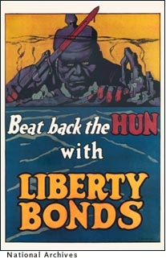
CPI Propaganda

Slide 7
Good for Business?
A way to smooth out “boom and bust” cycles of business
Consumers only buy when they truly need something – Victorian value: thrift
Advertising could stimulate interest – create a desire for more

Slide 8
A Complex Task
Early attempts were produced in-house
Effective advertising, however, required specialized focus and research into the nature of consumer values, wants, needs
Solution: Advertising as a business in itself
“Madison Avenue” Manhattan, NYC

Slide 9
Clash of Values
Advertisers: modernity, mechanized, based on routine, efficient, impersonal, emphasis on buying something new and to show off how modern you were
Consumers: Victorian, personal, family, often agrarian, independent, based on the work ethic and savings – you don’t just buy to be new, but rather save to buy something useful

Slide 10
Strategy
Use the old values to teach the new!
Advertising as therapy – product provides a benefit and facilitates a modern lifestyle
Personal endorser approach – made-up personalities
Betty Crocker, Marie Callender

Slide 11
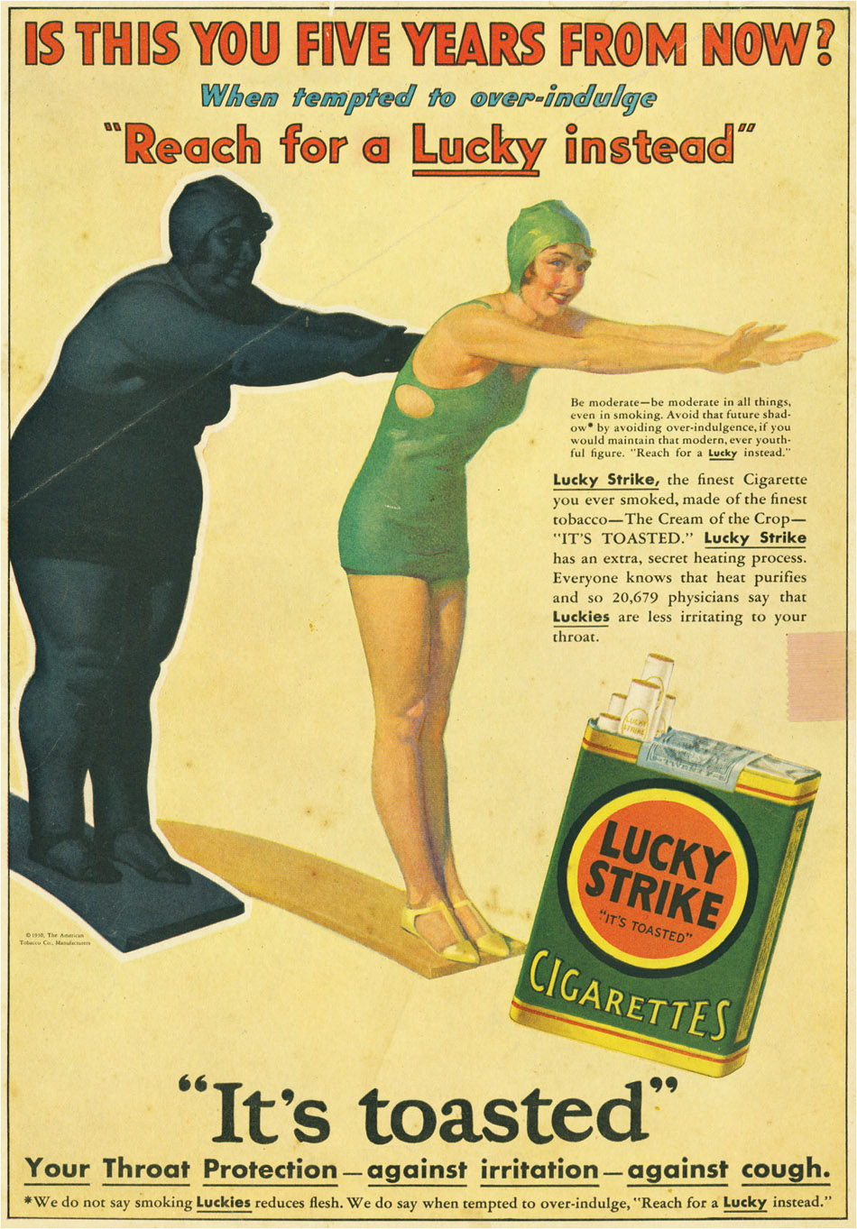

Slide 12
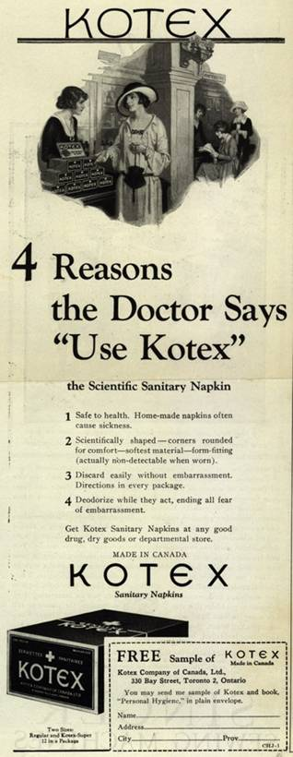
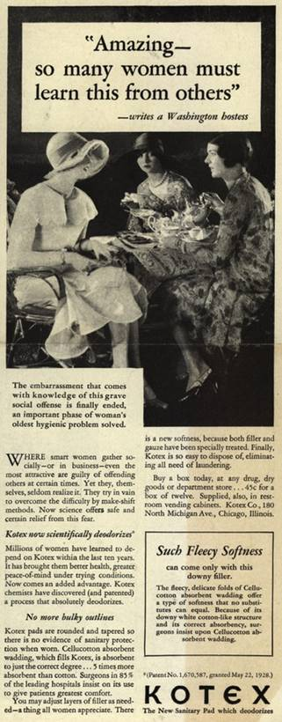
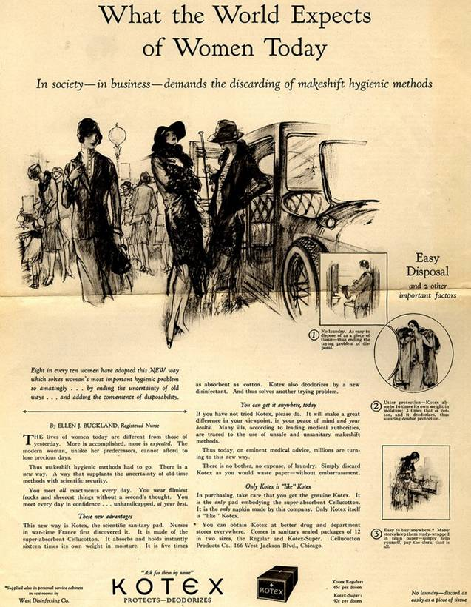

Slide 13
